Slide 1
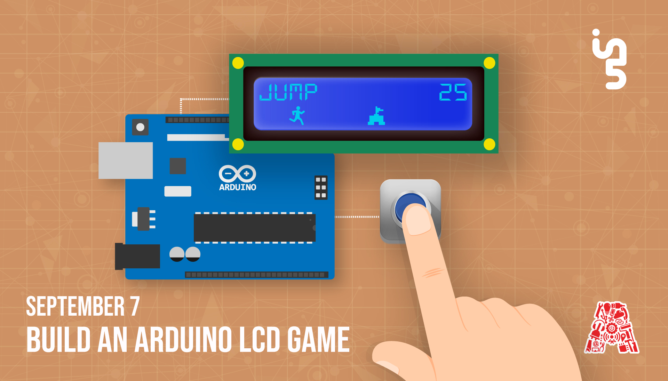

Slide 2
About the Assembly
A smart lab based out of In5 since Dec 2014
Over 250 free workshops done
ASSEMBLY: HACK - Embedded systems, iOT and hardware
ASSEMBLY: CODE - Software projects - APIs, frameworks, apps
Age range: 16-60 - students, professionals, entrepreneurs
Focus on smart technology and practical applications
Forum: members.theassembly.ae
Notes:
2

Slide 3
TAG US ON OUR SOCIAL MEDIA
FACEBOOK
TWITTER
INSTAGRAM
YOUTUBE
The Assembly (@MakeSmartThings)
@MakeSmartThings
@MakeSmartThings
The Assembly
Notes:
3

Slide 4
Overview
Purpose of this workshop
What is Arduino?
Setting up Arduino software
16x2 LCD and how to use it
OLED and how to use it
Trying out different games using these LCDs
Notes:
4

Slide 5
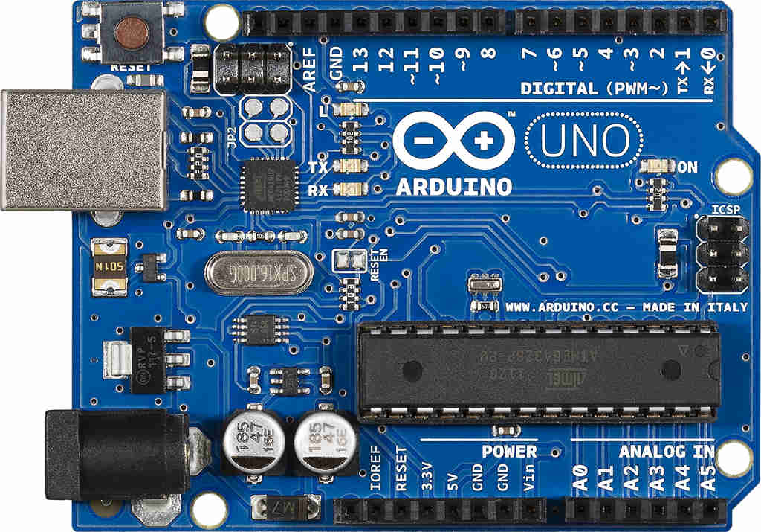
What is Arduino?
Microcontroller board based on Atmega328P
14 Digital pins / 6 Analog pins
Designed to make electronic
projects more accessible
Programmed using Arduino IDE
Open source

Slide 6
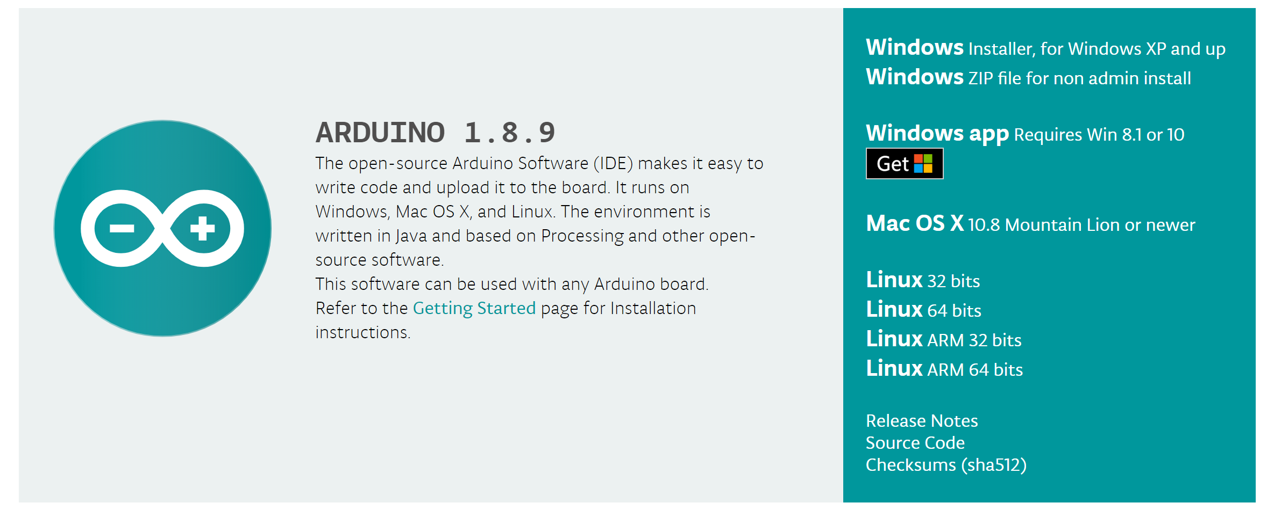
Arduino IDE
Accepts C and C++ programming
Link : https://www.arduino.cc/en/main/software

Slide 7
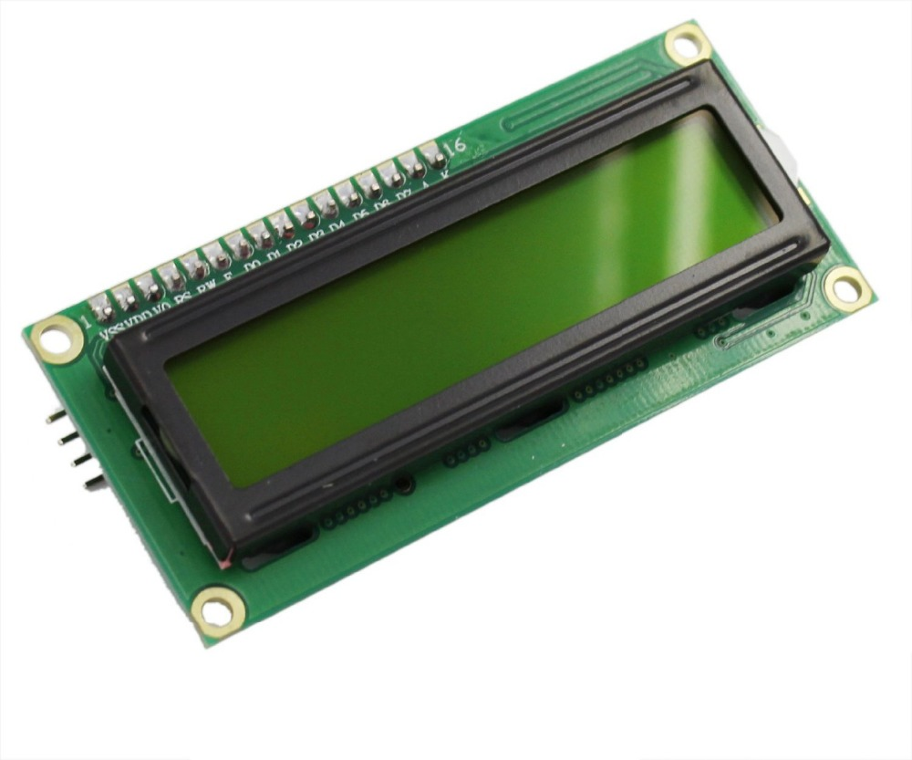
16x2 LCD (Pin Configuration)
Pin No | Function | Name
1 | Ground (0V) | Ground
2 | Supply voltage; 5V (4.7V – 5.3V) | Vcc
3 | Contrast adjustment; through a variable resistor | V_{EE}
4 | Selects command register when low; and data register when high | Register Select
5 | Low to write to the register; High to read from the register | Read/write
6 | Sends data to data pins when a high to low pulse is given | Enable
7 | 8-bit data pins | DB0
8 |  | DB1
9 |  | DB2
10 |  | DB3
11 |  | DB4
12 |  | DB5
13 |  | DB6
14 |  | DB7
15 | Backlight V_{CC} (5V) | Led+
16 | Backlight Ground (0V) | Led-

Slide 8
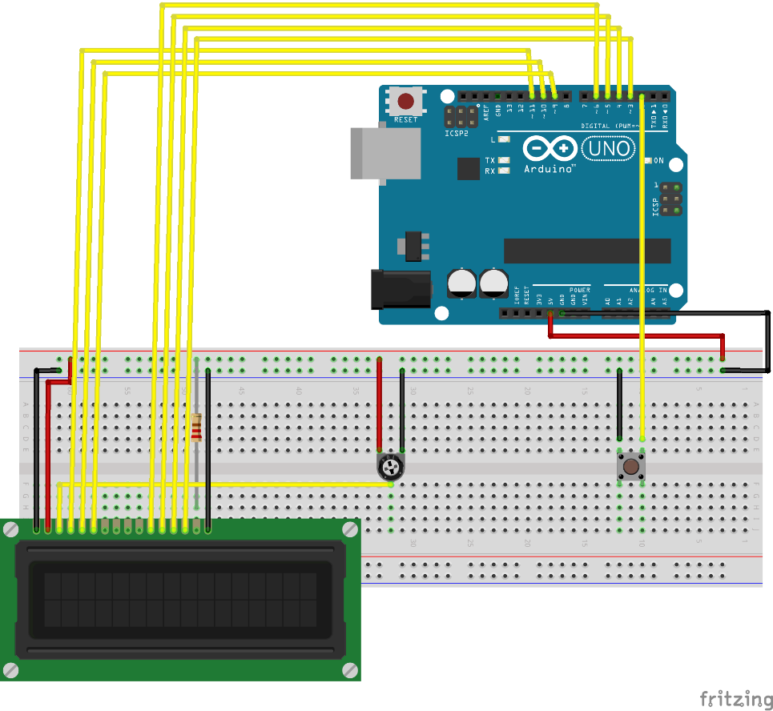
16x2 LCD (Connection)
Connect VSS to GND rail.
Connect VDD to 5V rail.
Connect Vo to the middle pin of the potentiometer.
Connect the other ends of the potentiometer to GND and VCC rails as in the diagram.
Connect RS Pin to Pin 11 on the Arduino.
Connect R/W Pin to Pin 10 on the Arduino.
Connect E Pin to Pin 9 on the Arduino.
Connect D4 Pin to Pin 6 on the Arduino.
Connect D5 Pin to Pin 5 on the Arduino.
Connect D6 Pin to Pin 4 on the Arduino.
Connect D7 Pin to Pin 3 on the Arduino.
Connect the Anode to 5V rail through a 220Ω resistor.
Connect the Cathode to the GND rail.

Slide 9
Software (Jump Game)
Library Used for LCD Approach:
LiquidCrystal Library for the LCD
Bounce2 Library for digital debouncing
Github Link : https://github.com/The-Assembly/LCD_game

Slide 10
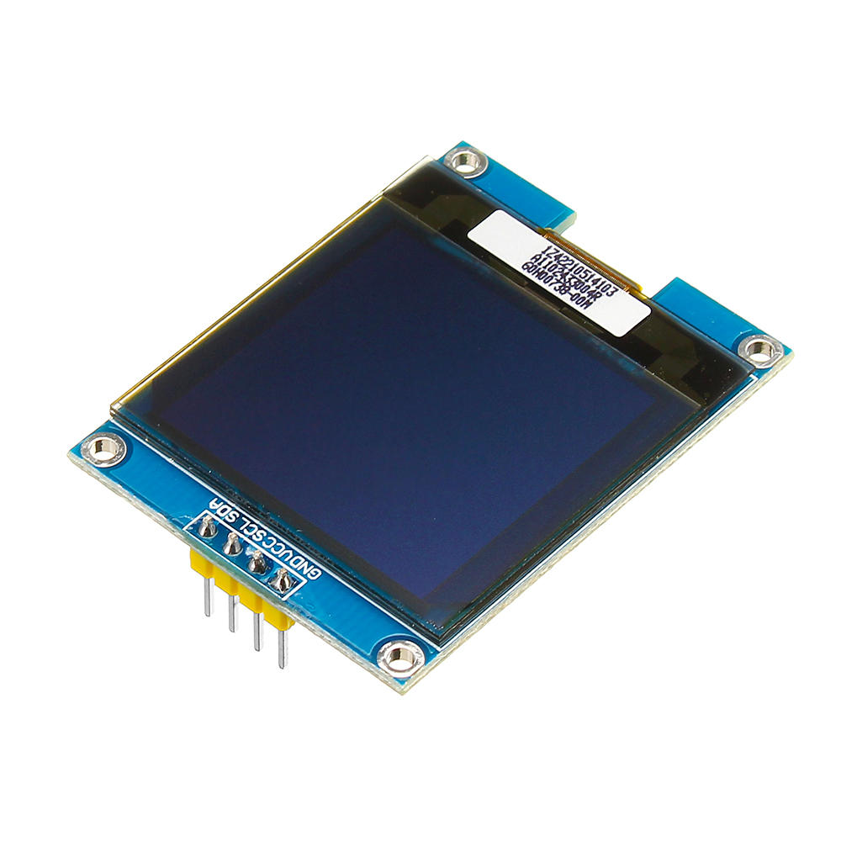
OLED
Pros and Cons of OLED approach: Pros: • Better games since more lines and pixels. • Introduction of AI to the game. • Simpler wiring and fewer components. • Simpler coding ensuring more successful completions on Workshop Day. Cons: • Smaller Screen.
Pros and Cons of LCD approach: Pros: • None. Cons: • More wiring for LCD (unless done by us before the workshop). • Only 1 game possible (Jump and avoid walls). • Fewer pixels since only 2 lines possible to write. • Harder code to process. • Crowded Breadboard (easy to make a wiring mistake). • No AI functionality which makes it more fun.

Slide 11
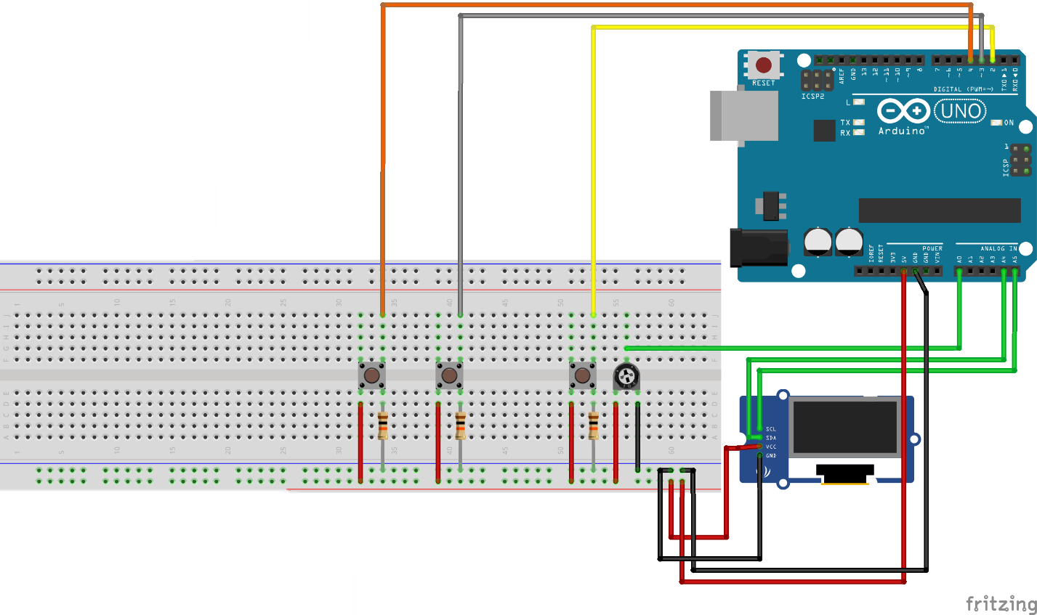
OLED (Connection)
Connect the Vcc pin to the 5V rail.
Connect the GND pin to the GND rail.
Connect the SCL pin to A5 Pin on the Arduino Uno.
Connect the SDA pin to A4 Pin on the Arduino Uno.
Connect the middle pin of potentiometer to A0 on Arduino.
Connect the other two legs of the potentiometer to GND and VCC.
Place three buttons on the breadboard.
Connect them accordingly using 10K resistors

Slide 12
Software (OLED game)
Library Used for OLED Approach:
• Bounce2.h Library for the digital debouncing • SPI.h Library for Serial Peripheral Interfacing • Wire.h Library for I2C communication • Adafruit_GFX.h Library for OLED Display • Adafruit_SSD1306.h Library for OLED Display
Github Link : https://github.com/The-Assembly/LCD_game

